Slide 1
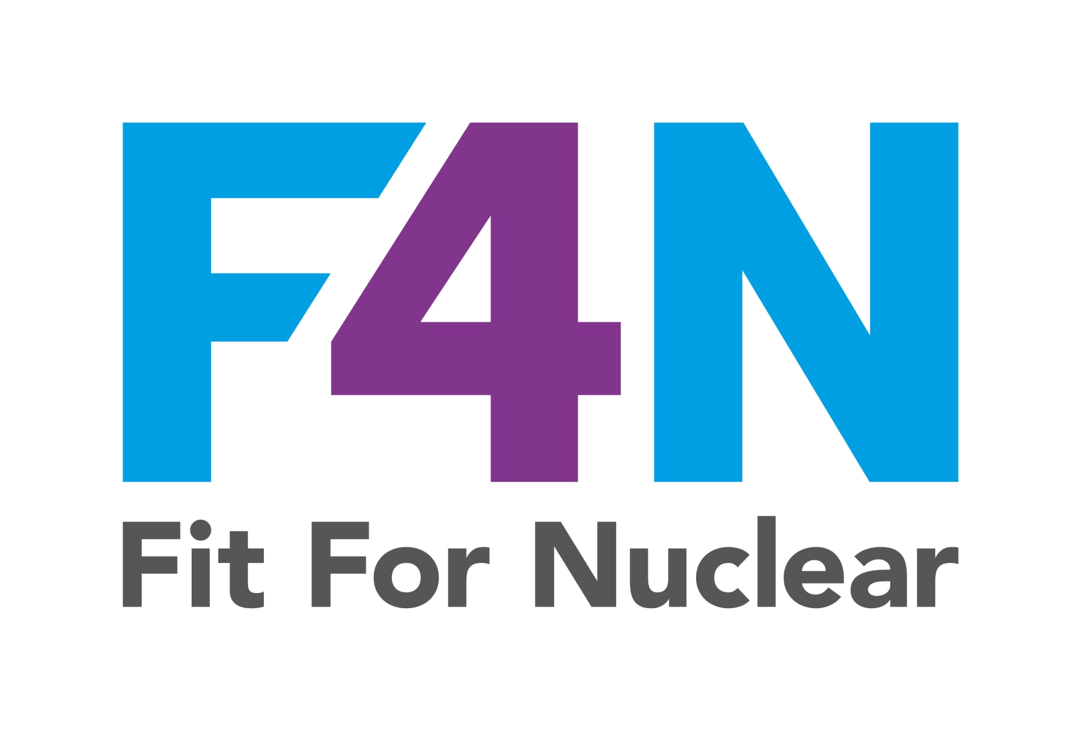


FIT FOR NUCLEAR
Mission, Vision & Values
Define who you are, why you exist, and how you operate
Strategy & Leadership Toolkit | SL-02
NucCol | Nuclear Collaboration Ltd · Fit For Nuclear Programme · Commercial in Confidence | 1

Slide 2
Why Mission, Vision & Values Matter for F4N
Strategy & Leadership — Category 1
Foundation of Strategy
Cultural Alignment
Nuclear Readiness
Your MVV is the bedrock of your entire strategic plan. Without clear direction, objectives lack meaning and staff lack alignment.
Employees who understand and connect with mission and values are more engaged, more productive, and more likely to stay.
F4N assessors look for embedded culture. MVV statements that are lived — not just displayed — are a strong signal of nuclear-ready leadership.
2
NucCol | Nuclear Collaboration Ltd · Fit For Nuclear Programme · Commercial in Confidence | 2

Slide 3
Our Mission Statement
What we do and why we exist
A mission statement answers: What do we do? Who do we do it for? What value do we deliver?
[Click to enter your mission statement here]
Example: 'We manufacture precision-engineered components for safety-critical industries, delivering quality, reliability and value to our customers and enabling the safe operation of critical national infrastructure.'
DRAFTING GUIDE
Keep it to 1–2 sentences: Short enough to memorise and display
Include your 'why': Not just what you do, but the purpose behind it
Avoid jargon and buzzwords: It should mean something to a new employee on day one
Review with all leadership: It must be genuinely agreed, not drafted by one person
3
NucCol | Nuclear Collaboration Ltd · Fit For Nuclear Programme · Commercial in Confidence | 3

Slide 4
Our Vision Statement
Where we are going
A vision statement answers: Where will we be in 3–5 years? What will we have achieved? What kind of organisation will we be?
[Click to enter your vision statement here]
Example: 'By 2028, to be a recognised Fit For Nuclear supplier with three major nuclear contracts, a workforce of 80 skilled engineers, and a reputation for quality and safety that enables our growth into international markets.'
Your vision should be:
Aspirational but achievable
Specific and time-bound
Mentions nuclear ambition
Agreed by the leadership team
4
NucCol | Nuclear Collaboration Ltd · Fit For Nuclear Programme · Commercial in Confidence | 4

Slide 5
Our Core Values
How we behave — every day, in every decision
SAFETY FIRST
QUALITY
INTEGRITY
[Click to describe what this value means in practice at your organisation]
[Click to describe what this value means in practice at your organisation]
[Click to describe what this value means in practice at your organisation]
TEAMWORK
CONTINUOUS
IMPROVEMENT
CUSTOMER
FOCUS
[Click to describe what this value means in practice at your organisation]
[Click to describe what this value means in practice]
[Click to describe what this value means in practice]
5
NucCol | Nuclear Collaboration Ltd · Fit For Nuclear Programme · Commercial in Confidence | 5

Slide 6
Communicating MVV to Your Team
How to make it real — not just a poster on the wall
On Boarding
Team Briefings
Appraisals
Include MVV in every new starter induction. Make it the first thing new employees learn about the company.
Reference mission and values in regular all-staff briefings. Connect company news to your values.
Link individual objectives and behaviours to company values. Reward those who embody them.
Physical Displays
Recognition
Leadership Walk
Display MVV prominently on site — entrance, shopfloor, meeting rooms. Not just corporate wallpaper — make them meaningful.
Recognise and celebrate employees who exemplify company values. Name the value when recognising.
Leaders reinforce values through their own visible behaviour on the shopfloor every day.
6
NucCol | Nuclear Collaboration Ltd · Fit For Nuclear Programme · Commercial in Confidence | 6

